Slide 1

Module 7: Configuring ETL to Selectively Refresh the SRMW
0/5
Analytics: Advanced Data Warehouse Developer
Notes:
Time: Lecture: 15 – 20 minutes; Labs: 30 – 40 minutes
Intent: To learn to configure the ETL to selectively refresh the SRMW.
Flow: Describe the business scenario to selectively refresh the SRMW; review steps to selectively refresh the SRMW; review things to consider before configuring the ETL to selectively refresh the SRMW
Key Terms:
Star Schema
ETL
DAC
Table Group
Subject Area
Execution Plan
7

Slide 2
Module Objectives
After completing this module you will be able to:
  Recognize the need to refresh a critical subject area more often than the rest of the Siebel Relationship Management Warehouse (SRMW)
  Configure the extraction, transformation, and loading (ETL) process to selectively refresh a star schema more frequently than the rest of the star schemas in the SRMW
Why you need to know:
  Allows you to refresh a selected set of SRMW tables independent of the regularly scheduled incremental ETL load
Notes:
Each objective and “why you need to know” should be stated aloud.

Slide 3
Business Challenge
Incremental ETL load run at scheduled intervals refreshes the entire SRMW
The SRMW needs to contain more up-to-date data on some tables to support near real-time reporting requirements
  For example, the Revenue data needs to be updated on an hourly basis
It is not practical to run the incremental ETL load or refresh the entire SRMW as often as necessary for real-time data support
  Impacts the Siebel transactional database and other source systems
Notes:
This slide describes the business need to configure the SRMW to support near real-time reporting requirements.
7

Slide 4
Business Solution: Selectively Refreshing the SRMW
Refresh a selected set of SRMW tables on a schedule independent of the regularly scheduled incremental ETL load
  The selected set of SRMW tables is refreshed at a higher frequency than the rest of the data in the data warehouse
    For example, the Revenue star schema is updated every 6 hours while the incremental ETL load updating the rest of the SRMW is run on a daily basis
  The impact on the source systems is minimized
Notes:
Selectively refreshing the SRMW is not the same as pruning the SRMW. Pruning allows you to inactive unwanted tables from getting loaded in the SRMW in order to speed up the load process. Whereas selectively refreshing the SRMW allows a selected subject area loaded more frequently than the rest of the data in the SRMW.

Slide 5
Selectively Refreshing the SRMW—Steps
0/6
1. Analyze the subject area
2. Identify table groups
3. Create subject area
4. Create execution plan
5. Schedule execution plan
6. Run execution plan
Notes:
This is a structuring slide. Do not teach the steps or concepts here because the following slides cover them in detail.
7

Slide 6
1. Analyze the Subject Area
1/6
Use the SRMW Data Model Reference guide to analyze the subject area and its stars
Subset of Revenue Dimensional Schema
CONTACT
(W_PERSON_D)
TERRITORY
(W_TERR_D)
ACCOUNT
(W_ORG_D)
Dimension table
OPPORTUNITY
(W_OPTY_D)
REVENUE
(W_REVN_F)
EMPLOYEE
(W_EMPLOYEE_D)
Fact table
PRODUCT
(W_PRODUCT_D)
OPEN DATE
(W_DAY_D)
INDUSTRY
(W_INDUSTRY_D)
Notes:
This slide shows only a subset of the Revenue dimensional schema. Please consult the data warehouse data model reference for the complete schema. The data warehouse data model reference guide is not part of the bookshelf but it is made available to all licensed customers and internal Siebel employees by signing a non-disclosure and confidentiality agreement.

Slide 7
1. Analyze the Subject Area Continued
1/6
Explore the star schema diagram
Identify the fact and dimension tables
Identify the primary fact table
  For example, W_REVN_F is the primary table of the Revenue star schema
Identify the unique physical dimension tables
  For example, W_DAY_D is the physical dimension table that supports both Open Date and Launch Date in the Revenue star schema
Notes:
This slide describes the process to analyze the subject areas for selective refresh.
7

Slide 8
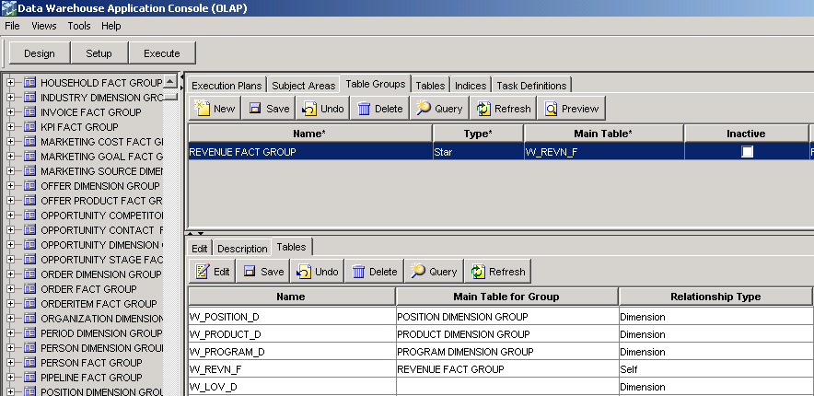
2. Identify Table Groups
2/6
Identify the missing tables in the Table Groups tab of the Design view in the Data Warehouse Application Console (DAC)
W_REVN_F is the main table in the REVENUE FACT GROUP table group
Notes:
This slide describes how to identify the needed table groups and their tables.

Slide 9
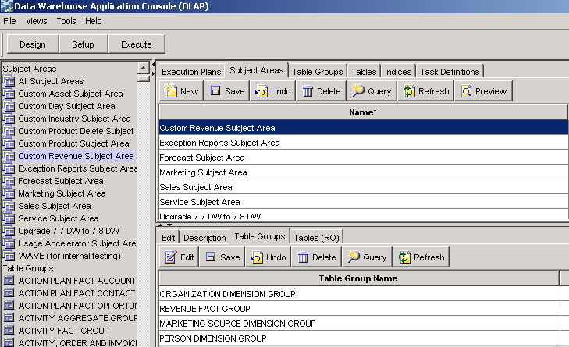
3. Create Subject Area
3/6
Assemble the table groups to include tables for selective refresh
Custom subject area
Table groups consists of tables for selective refresh
Notes:
This slide describes how to build a custom subject area.
7

Slide 10
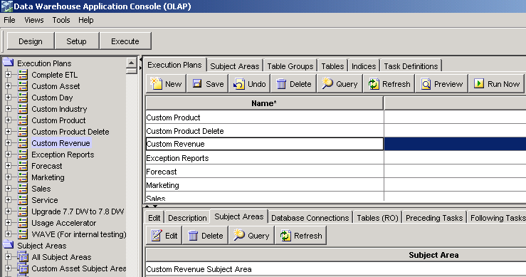
4. Create Execution Plan
4/6
Assemble the subject areas for selective refresh
Custom execution plan
Notes:
This slide describes how to build a custom execution plan.

Slide 11
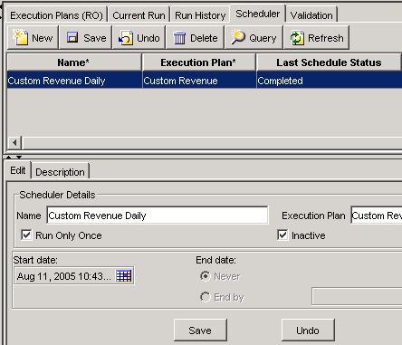
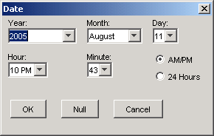
5. Schedule Execution Plan
5/6
Create a custom schedule for the newly created execution plan
Notes:
This slide describes how to create a custom schedule for an execution plan.
7

Slide 12
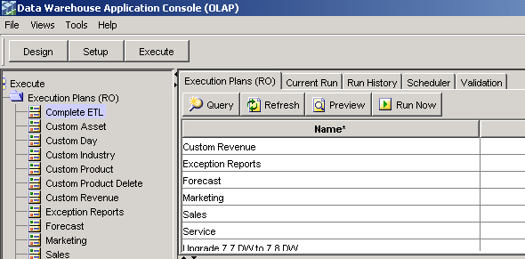
6. Run Execution Plan
6/6
Run the execution plan and monitor its progress
  Selectively refreshes the Revenue star schema
  Updates the revenue fact and associated dimension tables
Custom execution
plan
Notes:
This slide lists the steps used to execute the complete ETL. Students perform these steps in the labs.

Slide 13
Considerations
Selectively refreshing the data warehouse leaves a level of data latency between various data warehouse tables
Should be restricted to a few tables to minimize the impact to the Siebel transactional database and other source systems
Does not alleviate the need to run the incremental ETL load
Incremental ETL load refreshes the entire data warehouse including the tables that get selectively refreshed
Notes:
This slide lists some additional considerations that need to be taken into account when selectively refreshing the SRMW.
7

Slide 14
Summary
This module showed you how to:
  Recognize the need to refresh a critical subject area more often than the rest of the Siebel Relationship Management Warehouse (SRMW)
  Configure the extraction, transformation, and loading (ETL) process to selectively refresh a star schema more frequently than the rest of the star schemas in the SRMW
Notes:
This slide presents a summary of the topics covered in the module.

Slide 15
Lab
In the lab you will:
  Perform steps to selectively refresh a star schema independent of the regularly scheduled incremental ETL load
Notes:
Labs and Troubleshooting:
In this lab, students are asked to configure the ETL process to selectively refresh the Revenue dimensional schema.
7

